Slide 1
Programming HIVE
Session Six

Slide 2
Hive Overview
  Hive is an open source volunteer project under the Apache Software
  Foundation.
  It was developed at Facebook and donated to Apache.
  Hive is a data warehouse system for Hadoop that facilitates easy data
  summarization, ad-hoc queries, and the analysis of large datasets stored in
  Hadoop compatible file systems. Hive provides a mechanism to project
  structure onto this data and query the data using a SQL-like language called
  HiveQL.
  Hive allows traditional map/reduce programmers to plug in their custom
  mappers and reducers when it is inconvenient or inefficient to express this
  logic in HiveQL
  It allows use to define UDF, UDAF, UDTF and streaming to implement
  custom functionalities.
  It is good for doing Analytical Processing (OLAP).
Notes:
Ease of programming. It is trivial to achieve parallel execution of simple, "embarrassingly parallel" data analysis tasks. Complex tasks comprised of multiple interrelated data transformations are explicitly encoded as data flow sequences, making them easy to write, understand, and maintain.
Optimization opportunities. The way in which tasks are encoded permits the system to optimize their execution automatically, allowing the user to focus on semantics rather than efficiency.
Extensibility. Users can create their own functions to do special-purpose processing.

Slide 3
What is inside Hive?
Bin
Conf
Lib
.hiverc
.hivehistory
Java source code
Hive cli
Hive web interface
Hive JDBC/ODBC
Hive server
Thrift Server

Slide 4
Installing and Running Hive
To download the Hive, use the following url:
http://apache.techartifact.com/mirror/hive/hive-0.10.0/hive-0.10.0.tar.gz
Installing and Running:
Set Environment Variables HADOOP_HOME, HIVE_HOME, add Executables of
Hive bin to System Path.
To Install, Hive needs Hadoop, Hive Binary Distribution.
Hive uses RDBMS to store its Meta Information about schema and other
information. The default one is Apache Derby (Java DB). This works with one
client. To work with many clients any other RDBMS like MySQL is preferable.
Running Hive using Derby as RDBMS – No modifications are required to
Configuration parameters.
Running Hive using MySQL as RDBMS – It requires to modify the some
configuration
parameters like JDBC information of RDBMS are in hive-site.xml of Hive conf directory
Notes:
Execution Modes
Pig has two execution modes or exectypes:
Local Mode - To run Pig in local mode, you need access to a single machine; all files are installed and run using your local host and file system. Specify local mode using the -x flag (pig -x local).
Mapreduce Mode - To run Pig in mapreduce mode, you need access to a Hadoop cluster and HDFS installation. Mapreduce mode is the default mode; you can, but don't need to, specify it using the -x flag (pig OR pig -x mapreduce).

Slide 5
Contd.
Hive using Hive server to Interact with Outside World.
Hive uses Metastore (to store meta information) as any RDBMS.
If we run Metastore in MySQL which is running on other machine (remote machine), then we need to start the hiveserver (Thrift server) and run the metastore.
We need to modify the some of the configuration parameters in hive-site.xml like hive.metastore.uris etc
If hive uses local machine as Metastore, It directly access the Hive without hiveserver.
Hive server is useful when external clients are connecting to it by using JDBC or ODBC.

Slide 6
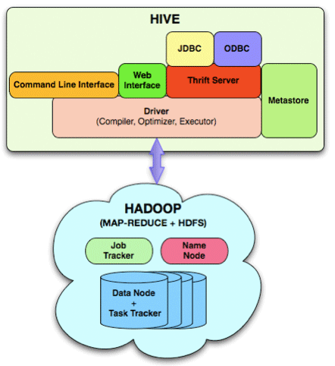
Hive Architecture

Slide 7
Data Types and Formats
It has two types of data types
Primitive data types
  tinyint, smallint, int, bigint, float, double, boolean, string etc
Collection data types
  Array, map, struct
File Formats:
There several file formats hive supports. Some of them are:
Text File
Sequence File
RCFile
Many more..

Slide 8
Hive Data Definition
Hive is a dialect of SQL.
It has a Data Definition Language, which are used for creating, altering, and
dropping databases, tables, views, functions, and indexes.
DDL is used for:
Create
Alter
Drop
Partitions
Buckets

Slide 9
Data Manipulation Language
Loading data into tables
Insert data into tables from queries
Creating table and loading them.
Exporting data

